Slide 1
January 26th
Common features in Neurodegenerative diseases:
*Aggregates
*Mitochondrial Dysfunction
*Apoptosis

Slide 2
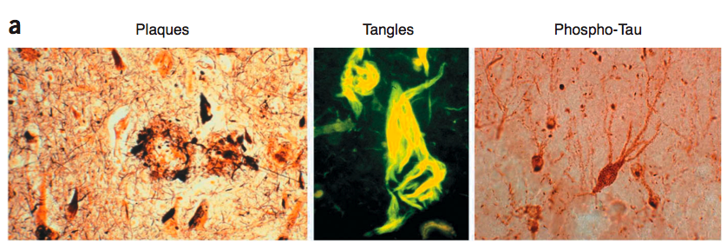
Deposition of fibrillar proteinacious material in Alzheimer’s disease
Alzheimer’s disease: characterized by extracellular depositions, the β-amyloid plaque, and intracellular depositions, the Neurofibrillary Tangles (NFT) comprised of Paired Helical Filaments (PHF), aggregates of hyperphosphorylated protein tau.
Bossy-Wetzel E, et al., Nat Med. 2004 Jul;10 Suppl:S2-9. Review.

Slide 3
Origin of β-amyloid and plaques:
Amyloid Precursor protein APP
APP
TMD
Aβ Oligomers Fibrils Plaques
Abeta levels as well as number and size of plaques increase with the progression of the disease
Origin of tau
Microtubule-associated protein that regulates cytoskeleton structure. When highly phosphorylated, tau is sequestered into PHF, and causes disruption of microtubules, leading to cell death.
ptau
PHF
Paired Helical Filaments
NFTs
Neurofibrillary tangles

Slide 4
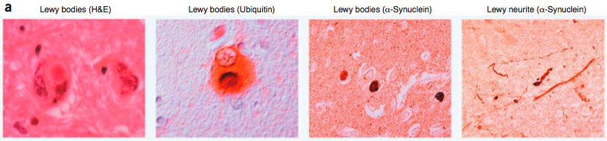
Deposition of fibrillar proteinacious material in Parkinson’s disease
Parkinson’s disease: characterized by dopaminergic neuronal loss and by intracellular depositions, the Lewy bodies, comprised of α-synuclein and ubiquitin, as the major components. Other components are proteasome and cytoskeletal proteins and other proteins that interact with α-synuclein.
Bossy-Wetzel E, et al., Nat Med. 2004 Jul;10 Suppl:S2-9. Review.

Slide 5
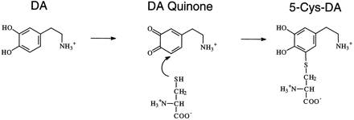
How α-synuclein is involved in Lewy bodies formation
Oxidation of Dopamine and subsequent interaction with α-synuclein or with Cys residues on different substrates: first step to the formation of
protofibrils
O₂
α-synuclein
on Tyr, Met or Lys
+ H₂O₂ + O₂⁻
Long-lived protofibrillar intermediate

Slide 6
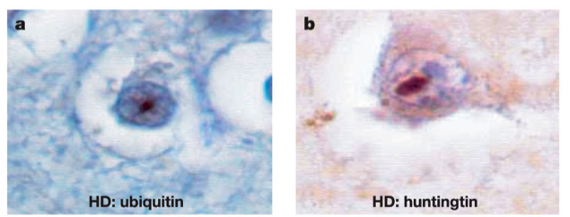
Deposition of fibrillar proteinacious material
in Huntington’s disease
Huntington’s disease: a progressive neurodegenerative disease characterized by CAG repeats causing glutamine expansion motifs (polyQ) in the N-terminal region of the protein huntingtin. Onset of the disease inversely correlates with the number of CAG repeats. In the HD, huntingtin forms intracellular inclusion bodies, containing material of cellular origin.
Ross CA, Poirier MA. Nat Med. 2004 Jul;10 Suppl:S10-7. Review.

Slide 7
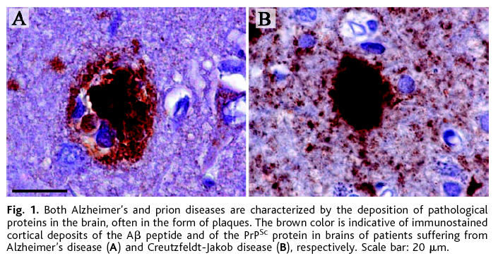
Deposition of fibrillar proteinacious material
in Creutzfeldt-Jakob’s disease (Prion’s disease)
Prion’s disease: neurodegenerative disorder caused by prions, via environmental stimuli or genetic mutations. Alterations in the prion protein lead to both intracellular and extracellular accumulation of amyloid aggregates, plaques, similar to those characteristic of AD, and positive to prion protein staining. Probably, replication and accumulation of the protease insensitive PrP^{sc} results in fibril formation and plaque deposition.
Alzheimer’s
Creutzfeldt-Jakob’s

Slide 8
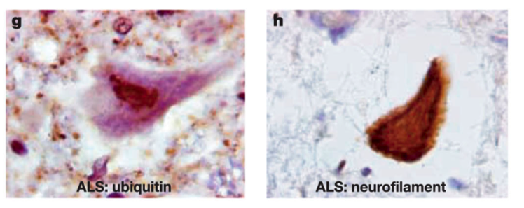
Deposition of fibrillar proteinacious material
in Amyotrophic Lateral Sclerosis (ALS)
ALS: a progressive fatal disease caused by the degeneration of lower motor neurons in the lateral horn of the spinal cord and the upper motor neurons of the cortex. Insoluble cytoplasmic inclusions are observed in the brain of ALS patients. These inclusions are composed also of SOD1 protein and ubiquitin.
Ross CA, Poirier MA. Nat Med. 2004 Jul;10 Suppl:S10-7. Review.

Slide 9
Common cellular pathways involved in the formation of insoluble aggregates
Many of them are related to aging, or can be triggered by particular toxins or by loss-of-function or gain-of-function protein mutants.
1- Mitochondrial dysfunction and increased oxidative stress, increased production of ROS
2-Decreased chaperones and proteasomal activity
3-Decreased protein degradation

Slide 10
Mitochondrial dysfunction and oxidative stress

Slide 11
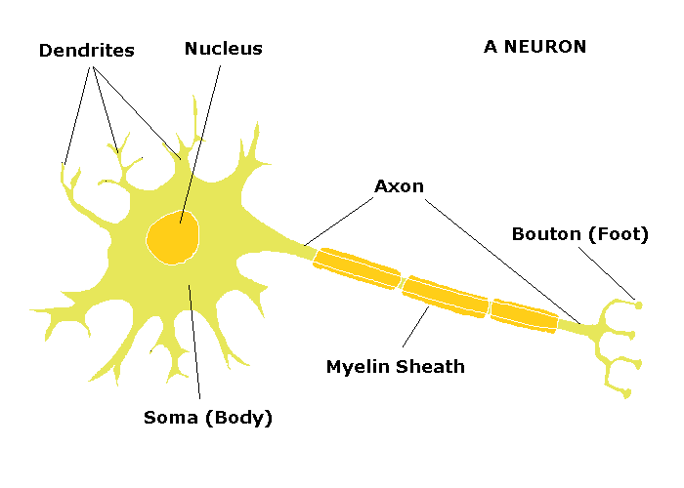
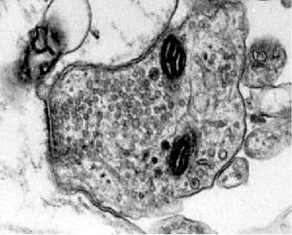
The neuron
The Synapse

Slide 12
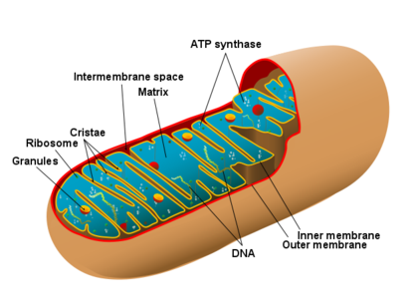
The mitochondrion

Slide 13
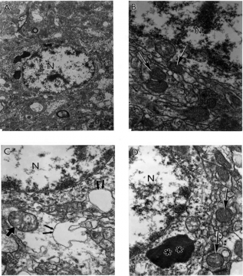
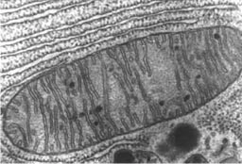
Mitochondria Dysfunction
Damaged
Hypoxic
Normal
lipofuscin
www.alsa.org
Partially and completely damaged mitochondria
**lipofuscin
Pharmaceuticals 2010, 3(1), 158-187

Slide 14
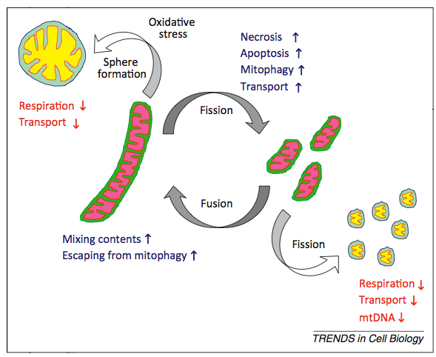
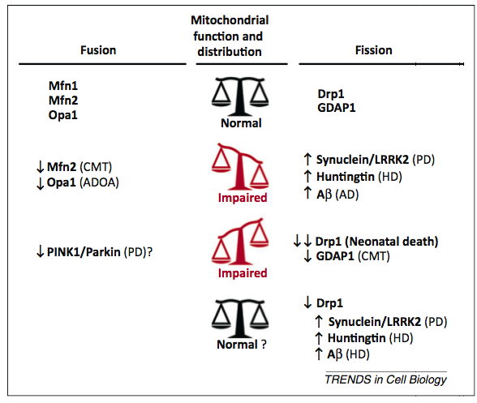
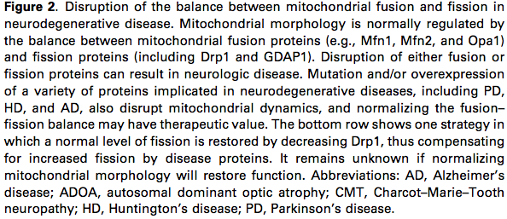
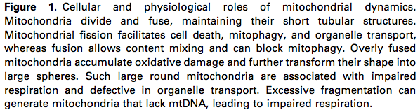
Mitochondrial dynamics in neurodegeneration
Physiologic Fusion and Fission
Balance or disease
Itoh et al., Trends in Cell Biology 2012

Slide 15
https://www.youtube.com/watch?v=Pf1kIs7gQVk

Slide 16
Mitochondrial activity
The role of the mitochondria is to produce ATP through a process called Oxidative Phosphorylation. This process occurs thanks to a complex system of redox reactions that moves H⁺ and e⁻ between the inner membrane and the inter space of the mitochondrion, generating H⁺ gradient that moves the reactions.
H₂O is a product of this reaction
oxidase
O₂ + e⁻ O₂^{-.} Superoxide ion
dismutase
O₂^{-.} + e⁻ + 2H⁺ H₂O₂ Hydrogen peroxide
catalase
H₂O₂ + e⁻ + H⁺ OH. + H₂O Hydroxyl radical
OH. + e⁻ + H⁺ H₂O
This is the last step, last reaction of the cellular respiration upon the action of cytochrome c oxidase, aka Complex IV.

Slide 17
Cellular Respiration
1- This process occurs thanks to a H⁺ gradient generated through the transport of electrons between the two sides of the inner membrane. Many proteins are involved in this process, which is based on a chain of redox reactions. Among these, the NADH dehydrogenase, also called Complex I, is a proton pump, crucially involved in the transport of 4 H⁺, creating a strong H⁺ gradient. Lack or loss of function of Complex I leads to e⁻ leakage in the intermembrane space, and in the cytosol, initiating the process that leads to the formation of Reactive Oxygen Species, ROS.
2- e⁻ are transported to proteins thanks to e⁻ transporters like Fe-S and cytochrome c, involved in different moments of the mitochondrial respiration. The succinate dehydrogenase, also called Complex II, moves e⁻ from intermediate species, and cytochrome bc complex, also called Complex III, move e⁻ to the cytochrome c and pumps back 4 H⁺ from the inter-space to the inner-space, creating a strong H⁺ gradient.
3- Cytochrome c oxidase, also called Complex IV, removes the e⁻ from cytochrome c molecules and transfers them to molecular oxygen O₂, creating H₂O. It also moves 4 H⁺ back out of the inner space of the mitochondrion, re-initiating the H⁺ gradient.

Slide 18
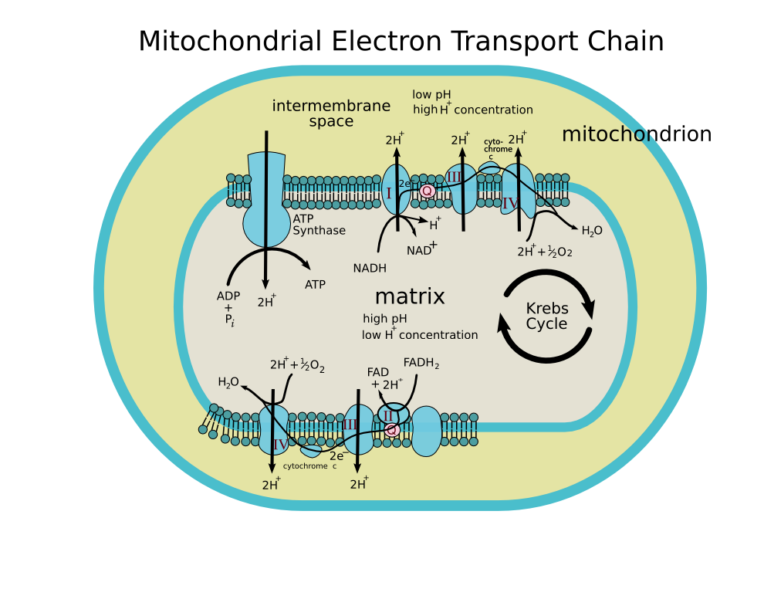

Slide 19
During synthesis of molecules of water, numerous Reactive Oxygen Species (ROS) are generated
mitochondrial deficit related to either aging or protein dysfunction may lead to leakage of reactive species out of the mitochondrion into the cytosol through Voltage Dependent Anion Channel (VDAC), in particular
O₂^{-.} Superoxide ion and e⁻
This phenomenon increases oxidative stress and promotes the generation of other ROS within the cell, being toxic for the cell.

Slide 20
How oxidative stress is toxic?
By promoting oxidation of
1- proteins
2-lipids
3-cathecolamine (adrenaline, noradrenaline, dopamine)
4-DNA
Loss of function, impaired cellular activity and death

Slide 21
Antioxidant proteins and enzymes
Superoxide Dismutases SOD: control the dismutation reaction that leads from ion superoxide O₂^{-.} to hydrogen peroxide H₂O₂
- 3 different types, SOD1, SOD2, SOD3 localized in different intracellular compartments
-SOD1 (CuZnSOD): localized mainly in cytosol and nucleus and in the intermembrane space of the mitochondria. Abundantly expressed ubiquitously, , and high levels of expression in the brain and spinal cord. More than 100 mutations are found in genetic ALS, motor neuron disease in which SOD1 shows a gain of toxic function (SOD1 KO mice have no motorneuron degeneration).
-SOD2 (MnSOD): essential for mitochondrial integrity. When nitrosylated by peroxinitrate, SOD2 loses its function.
-SOD3: low expression profile in brain.

Slide 22
APOPTOSIS

Slide 23
Apoptosis: mechanism of programmed cell death
Steps that lead to apoptosis:
1-Condensation of nuclear chromatin
2-Compaction of cytosolic organelles and blebbing on the cell surface
3-Decrease in cell volume (the cell shrinks)
4-Alteration of plasma membrane
5-Phagocytosis

Slide 24
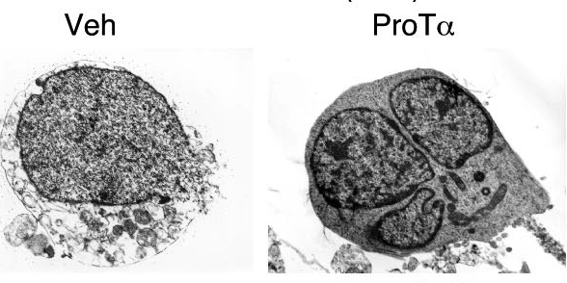
Structural differences between necrosis and apoptosis
Necrosis
Apoptosis
Necrosis is characterized by membrane destruction and loss of electron density in the cytosol. Apoptotic features of nuclear fragmentation, but no substantial necrotic features, are observed in neurons treated with 25 pmol/cm2 ProTα
The Journal of Cell Biology, Vol. 176, No. 6, March 12, 2007 853–862

Slide 25
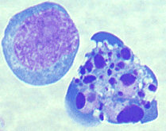
APOPTOSIS
Apoptosis is of Greek origin meaning "falling off". The term is used in an analogy to the apparent suicide of leaves resulting in the very visible color changes associated with the Autumn/Fall and that eventually leads to the leaves falling from the trees. Similarly, cells go through a predetermined sequence of events resulting in death and removal from the body.

Slide 26
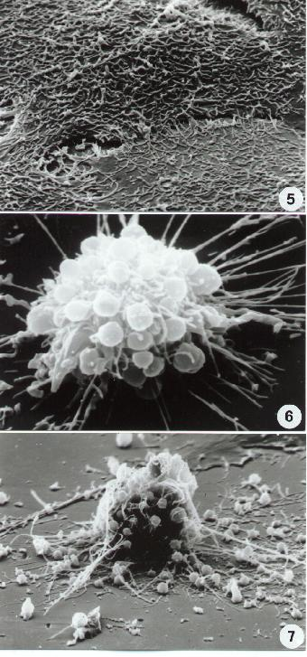
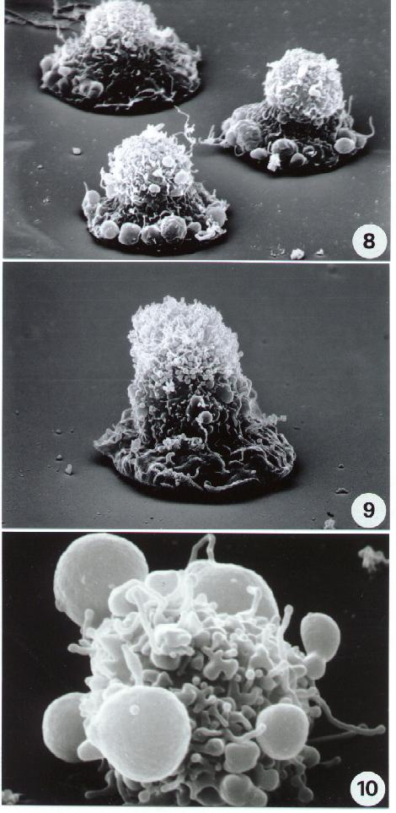
5-10. Scanning electron microscopy. Epithelial cells. Different stages. Flat cells (Fig. 5) undergo different forms of rounding, surface blebbing and cell retraction (6-9) preceding the typical apoptotic figure shown in (10).

Slide 27
CASPASES
These proteins initiate apoptosis, and could be released from the mitochondria following mitochondrial injury or dysfunction
Caspases 1-14, divided in 3 groups depending on their structure and substrate specificity.
- Normally in the inactivated form of pro-caspases

Slide 28
Group I: Caspase 1, 4, 5, 13
Group II: Caspase 2, 3, 7 action of group II caspases on substrates determines:
-no cell repair
-no cell cycle progression
-DNA fragmentation
Group III: Caspase 6, 8, 9, 10 will activate caspases of group I and II, beginning a chain reaction that leads to programmed cell death

Slide 29
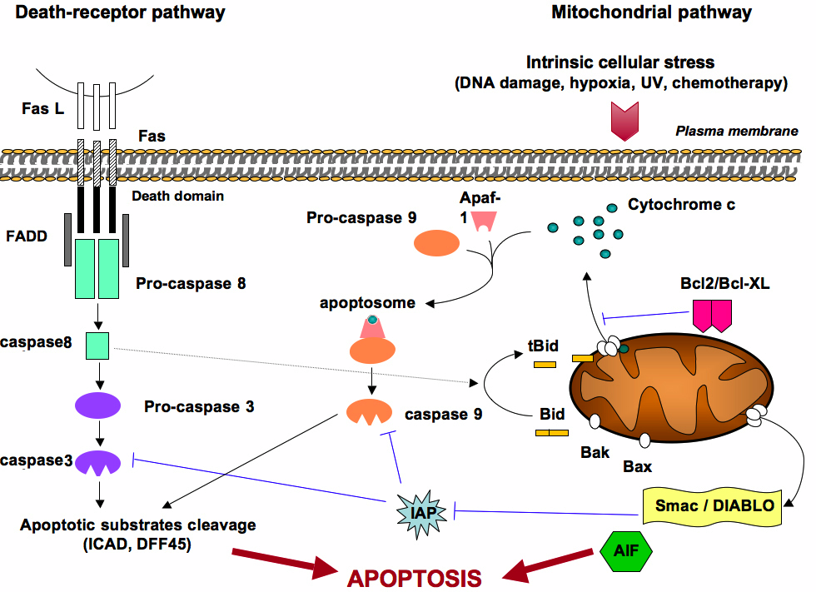
Apoptotic Pathways
http://www.bioscience.org/
Mitochondrial apoptotic pathway. Death can be induced by the binding of ligands (such as FasL) to specific receptors (such as FAS) located at the cell surface. FAS contains a cytoplasmic death domain where FADD (Fas-associated death domain) can bind in presence of FasL, and recruit Pro-caspase 8 for subsequent activation in caspase 8. This induces caspase 3 activation. Caspase 3 cleaves I-CAD, the inhibitor of CAD (Caspase-activated DNase), which is released to enter the nucleus and cleaves DNA. In addition caspase 8 cleaves Bid protein, resulting in a truncated Bid (tBid) that, upon dimerisation of Bax or Bad, causes the release of cytochrome c from mitochondria. The mechanisms by which Bax leads to mitochondrial membrane permeabilisation and subsequent release of pro-apoptotic factors still remain unclear. It is proposed that Bax could interact with the permeability transition pore, or form channels by self-oligomerization. This leads to the mitochondrial release of cytochrome c and Smac/Diablo (Smac: second mitochondrial- derived activator of caspase; Diablo: direct IAP-binding protein with low pI), AIF (apoptosis inducing factor) and various procaspases. Bcl2 inhibits the release of cytochrome C and AIF in the cytoplasm and prevents the variation of the permeability transition pore. In the cytosol, cytochrome c binds to Apaf-1 (apoptosis- protease- activating factor). Both proteins form the apoptosome, which converts procaspase 9 in caspase 9. This results in activation of downstream effector caspases. Smac/DIABLO binds to IAP (Inhibitors of apoptosis) and prevent them from inhibition of the caspase 9 and caspase 3 activation. AIF has an indirect role in chromosome degradation as it activates endonuclease G, a DNase that moves from the mitochondria to the nucleus during apoptosis. Interestingly to note, the mtDNA is not fragmented during apoptosis.

Slide 30
Exogenous Pathways to Apoptosis
These pathways work through the activation of cell surface death receptors, activated downstream specific stimuli.
Fas/CD95 TNFαR1 (tumor necrosis factor a receptor 1)
The DD (Death Domain) of these receptor binds to adaptor proteins with death effector domain (FADD-Fas associated protein with death domain) forming a complex that contains also (pro)caspase 8, which can be activated to caspase 8 by caspases or other proteins.
This exogenous pathway is involved in Huntington’s diseases, Stroke, Parkinson, but not in AD. However, caspase 8 is activated in cultured cell models, but in neurons this pathway is resistant to activation of death cell receptor. Thus it is still not clear how this pathway leads to neuronal death.

Slide 31
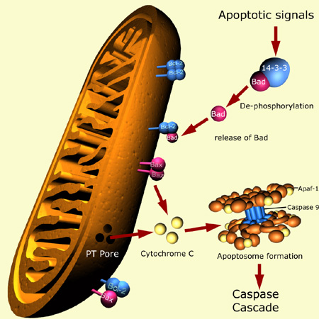
Endogenous pathway
Starts from mitochondria dysfunction!!!
It is based on the release of cytochrome c out of the mitochondrion and subsequent activation of caspases.
The mitochondrion may disrupt following two alternative mechanisms:
osmotic disequilibrium that leads to expansion of the matrix space, swelling of intracellular structures and rupture of the outer membrane
-opening of channels in the outer membrane
http://www.sgul.ac.uk

Slide 32
-In any event, cytochrome c forms complexes with the apoptosis protease activating factor APAF1, and procaspase 9.
-This leads to activation of procaspase 9 to caspase 9, that will ultimately lead to activation of caspase 3
In this phase, ROS production increases and there is a massive release of proapoptotic stimuli from the mitochondria, such as:
*AIF (Apoptotic Inducing Factor)
*SMAC (Second Mitochondria Derived Activator of Caspases)
*DIABLO (Direct Inhibitor of Apoptosis AIT-Binding protein with Low pI
*also antiapoptotic proteins belonging to Bcl2 family are released. The antiapoptotic properties of Bcl2 are characterized by the capability of the protein to bind to APAF1 and to regulate the amount of cytochrome c released in the cytosol.
AIF is released in the cytosol during the induction phase, translocates to the nucleus where it induces DNA fragmentation in large scale

Slide 33
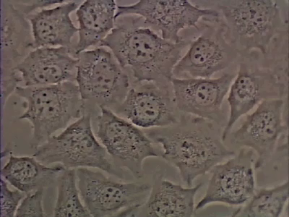
Essential Cell Biology Third Edition
Garland Science 2010

Slide 34
Proteostasis or Protein Homeostasis

Slide 35
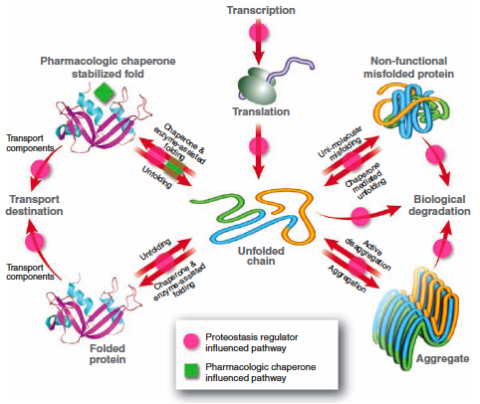
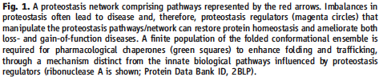
Proteostasis: Protein Homeostasis

Slide 36
Proteostasis: regulation of the homeostasis of proteins during the life span of a cell
Homeostasis: the property of a system to regulate its internal environment and maintaining a stable, constant condition.
Proteostasis: “refers to controlling the concentration, conformation, binding interaction, and location of individual proteins, by re-adapting the innate biology of the cell, often through transcriptional and translational mechanisms”.

Slide 37
Quality Control
The competition between cellular protein folding and degradation.
It has a crucial role maintaining a correct proteostasis.
Crucial role of quality control during aging

Slide 38
Mechanisms of protein degradation
The Ubiquitin Proteasome Pathway
The Lysosomal Pathway
Autophagy

